Slide 1
Chongqing University of Technology
ATAI
Advanced Technique of Artificial Intelligence
Chongqing University of Technology
Luu Anh Tuan* Darsh J Shah* Regina Barzilay
Computer Science and Artificial Intelligence Lab, MIT
Capturing Greater Context for Question Generation
——AAAI 2020
2021.01.18 • ChongQing
Reported by Jia Wang

Slide 2
Chongqing University of Technology
ATAI
Advanced Technique of Artificial Intelligence
Chongqing University of Technology
1.Introduction
2.Method
3.Experiments
4.Conclusion

Slide 3
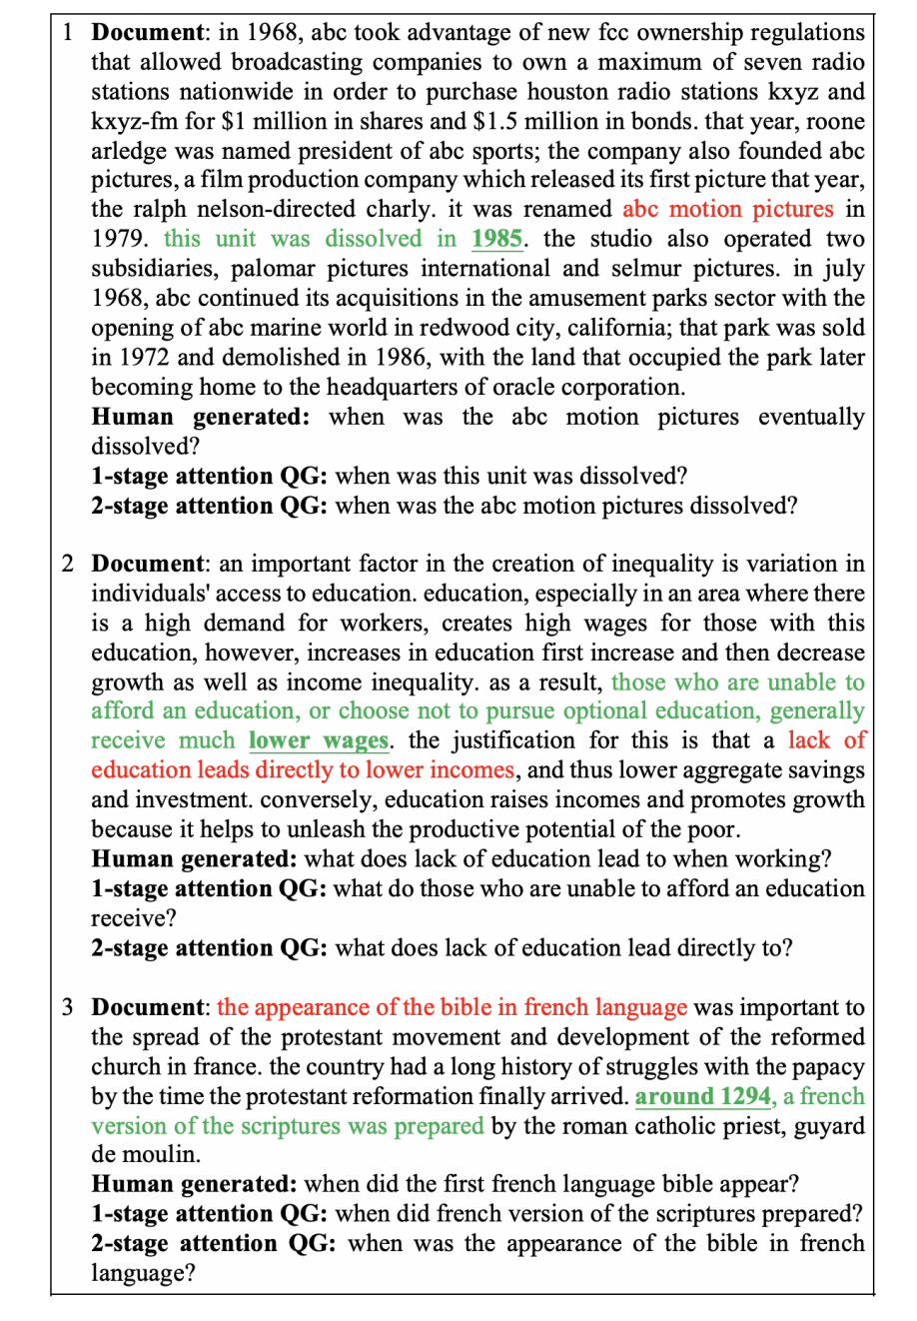
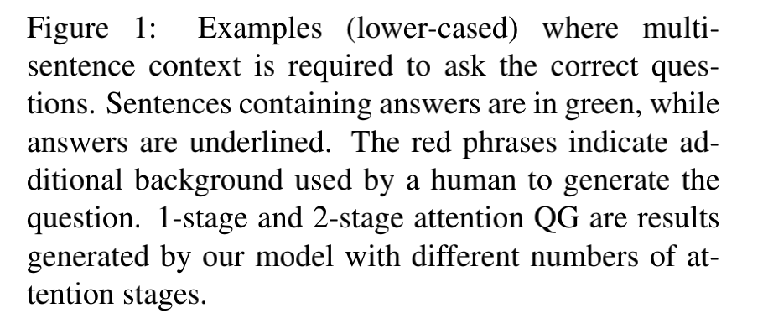
Introduction

Slide 4
Introduction
The final document representation, contains relevant answer context cues by means of attention weights. Through a copy-generate decoding mechanism, where at each step a word is either copied from the input or generated from the vocabulary, the attention weights guide the generation of the context words to produce high quality questions.
We evaluate our hypothesis of using a controllable context to generate questions
on three different QA datasets — SQuAD, MS MARCO, and NewsQA.
Our method strongly outperforms existing state-of-the-art models by an average absolute increase of 1.56 Rouge, 0.97 Meteor and 0.81 Bleu scores over the previous best reported results on all three datasets.
Notes:
Aspect：picture quality
Polarity：positive
Aspect：battery life
Polarity：negative

Slide 5
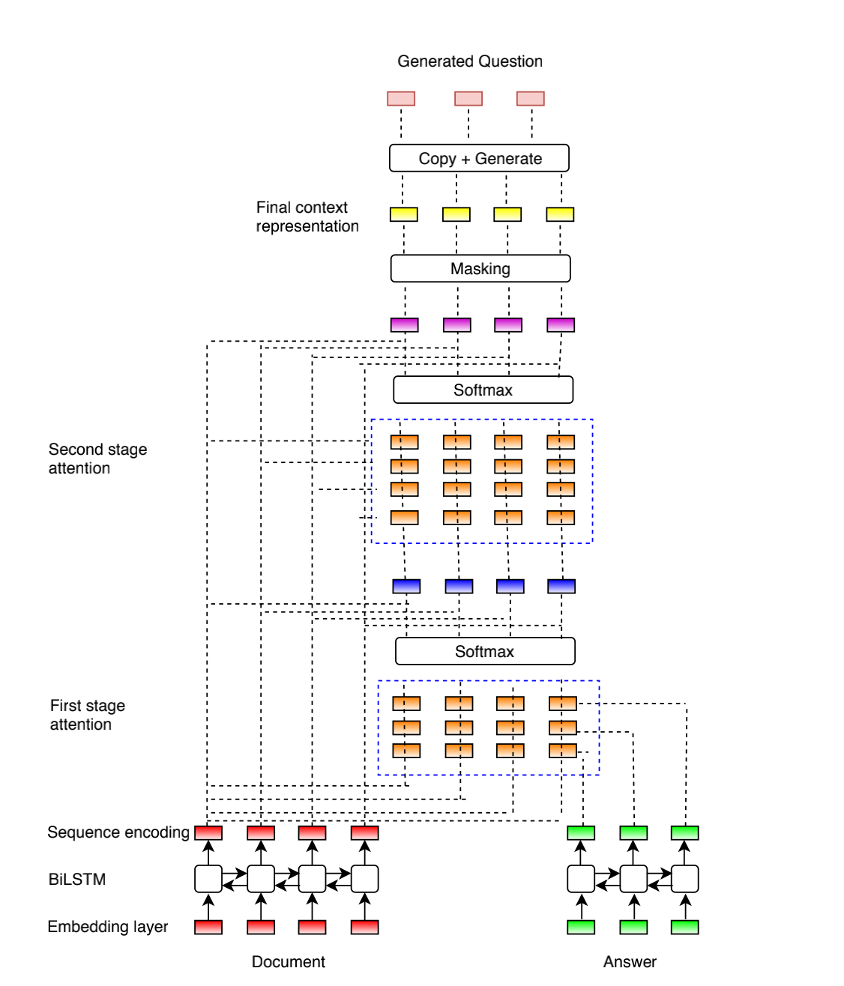
Method

Slide 6
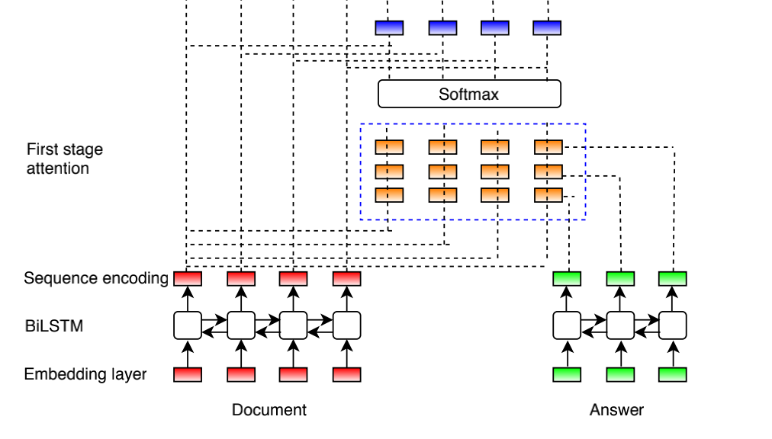
Method
Initial Stage (context with direct relation to answer)
is the soft matching matrix

Slide 7
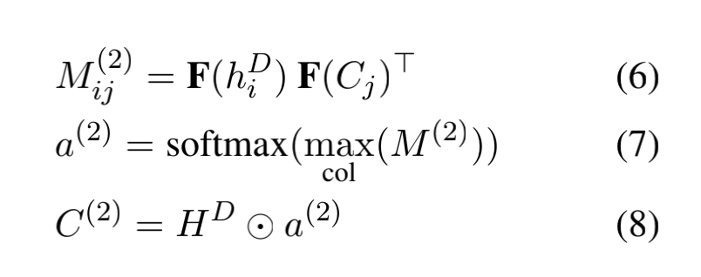
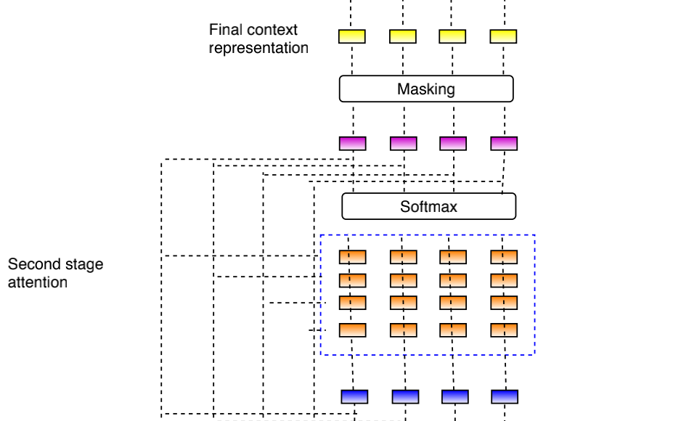
Method
Iterative Stage (enhance the context with indirect relations)

Slide 8
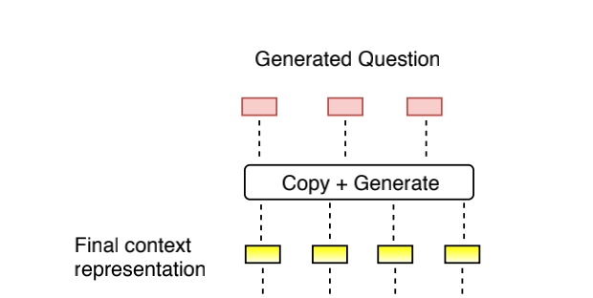
Method
the word-embedding of the previous time-step’s output

Slide 9
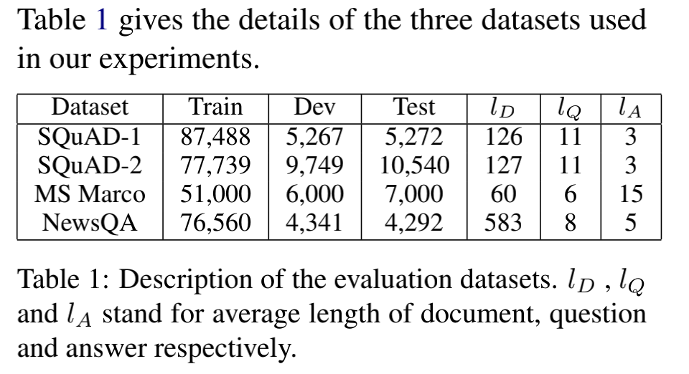
Experiments

Slide 10
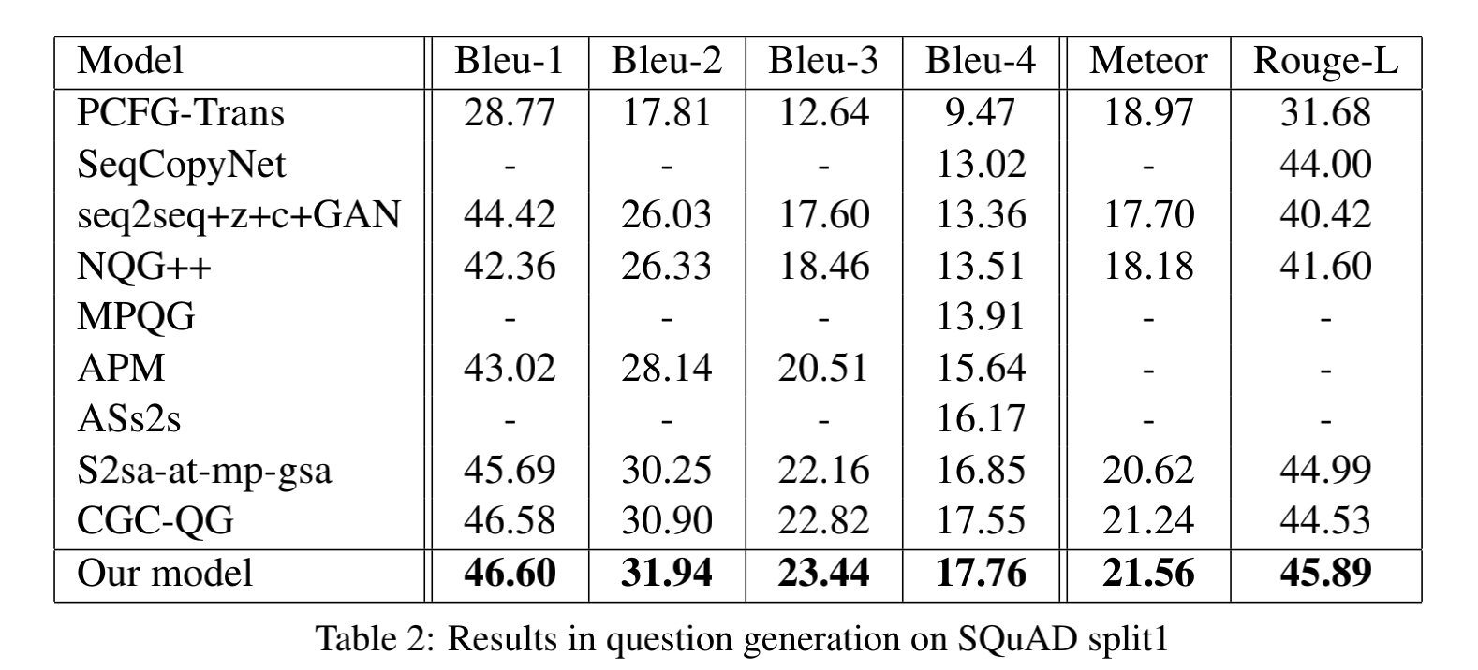
Experiments

Slide 11
Experiments

Slide 12
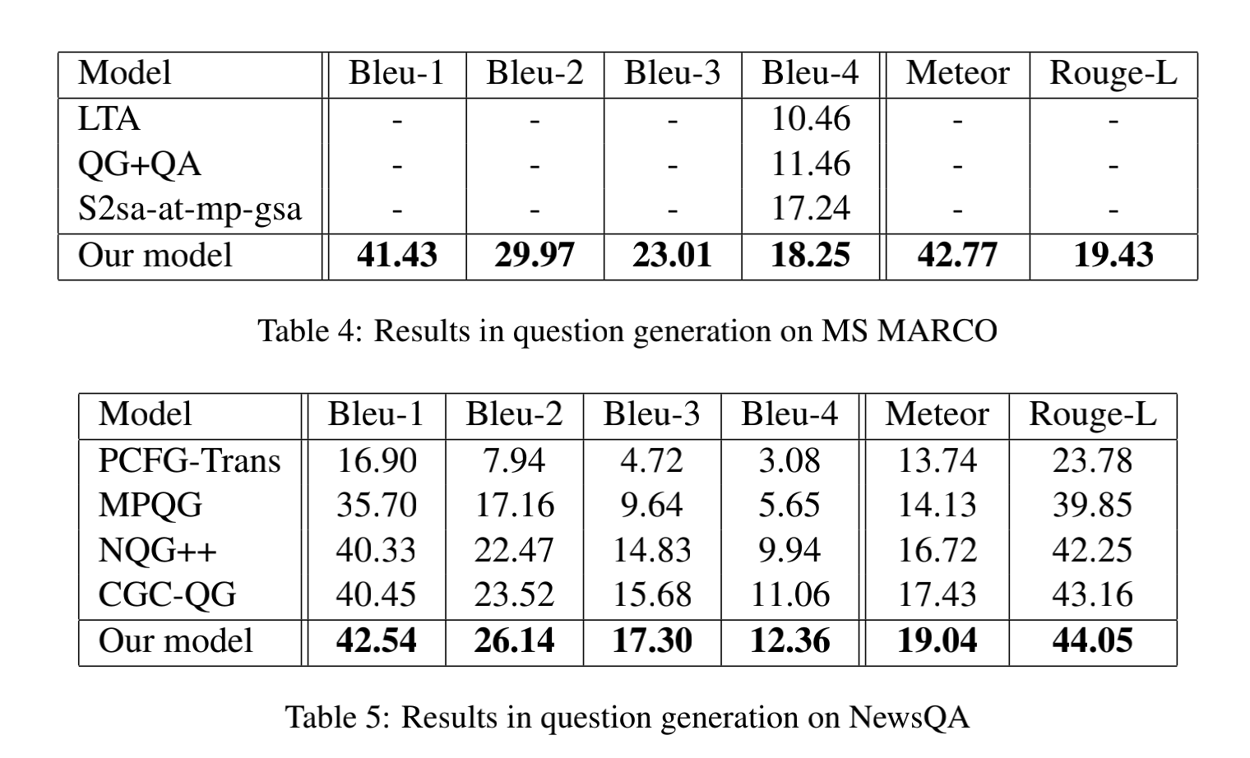
Experiments

Slide 13
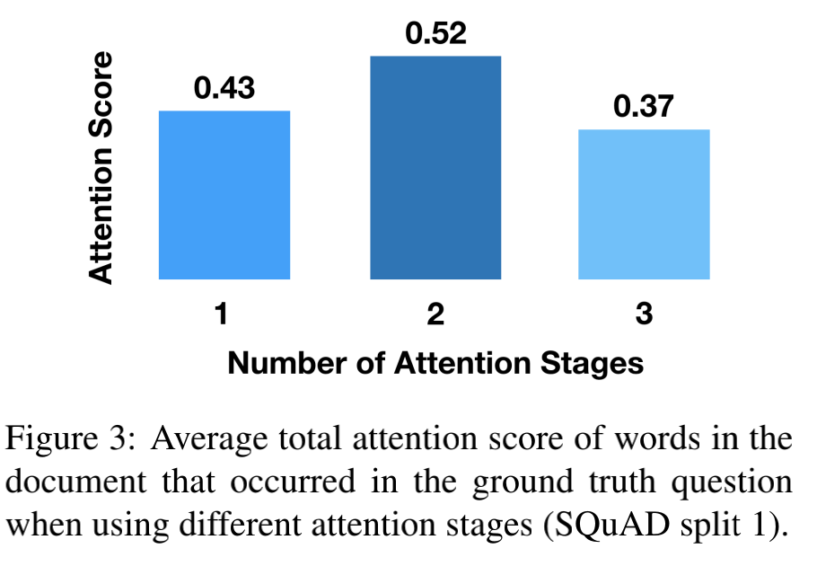
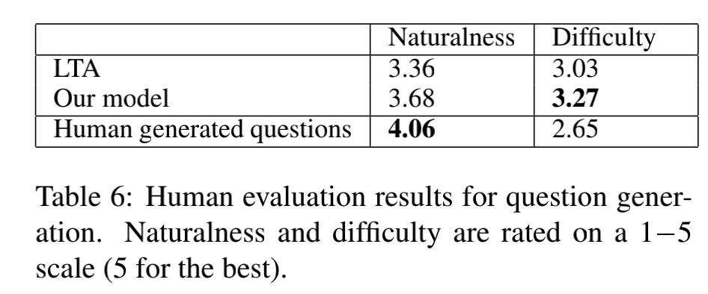
Experiments

Slide 14
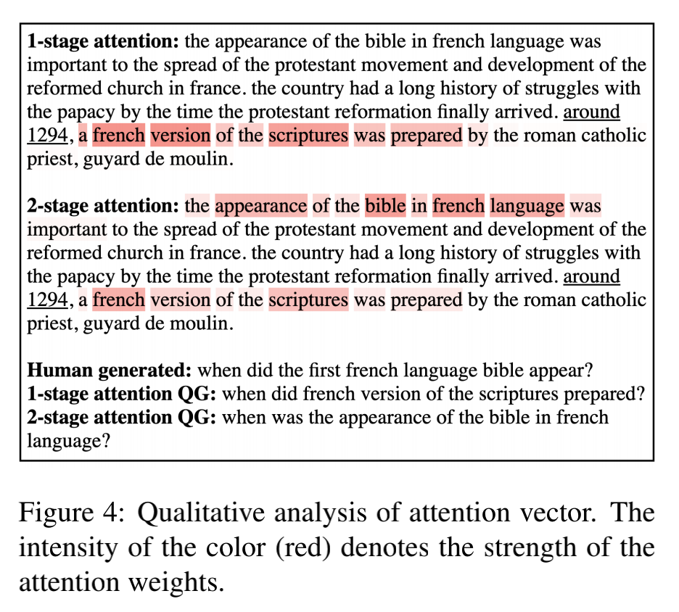
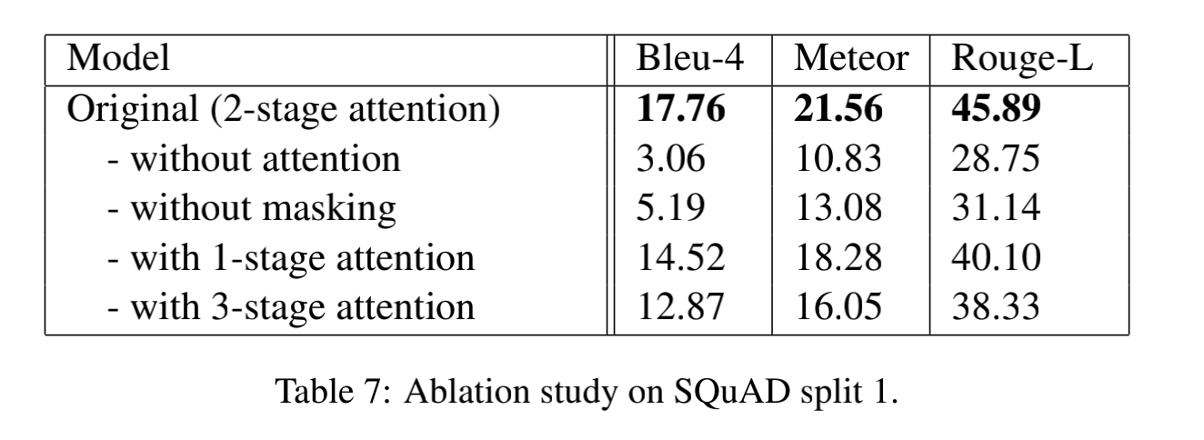
Experiments

Slide 15
Conclusion
In this paper, we proposed a novel document-level approach for question generation by using multistep recursive attention mechanism on the document and answer representation to extend the relevant context. We demonstrate that taking additional attention steps helps learn a more relevant context, leading to a better quality of generated questions. We evaluate our method on three QA datasets - SQuAD, MS MARCO and NewsQA, and set the new state-of-the-art results in question generation for all of them.

Slide 16
Thank you!

